Slide 1
CONVERSATIONS ON PROSTATE CANCER
HAROLD A. HARVEY, MD

Slide 2
PROSTATE CANCER
How Common is the Disease ?
An unequal burden in African-Americans

Slide 3
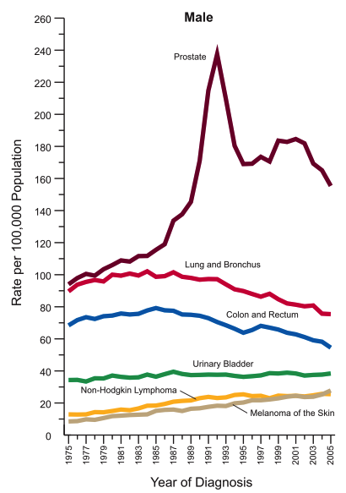
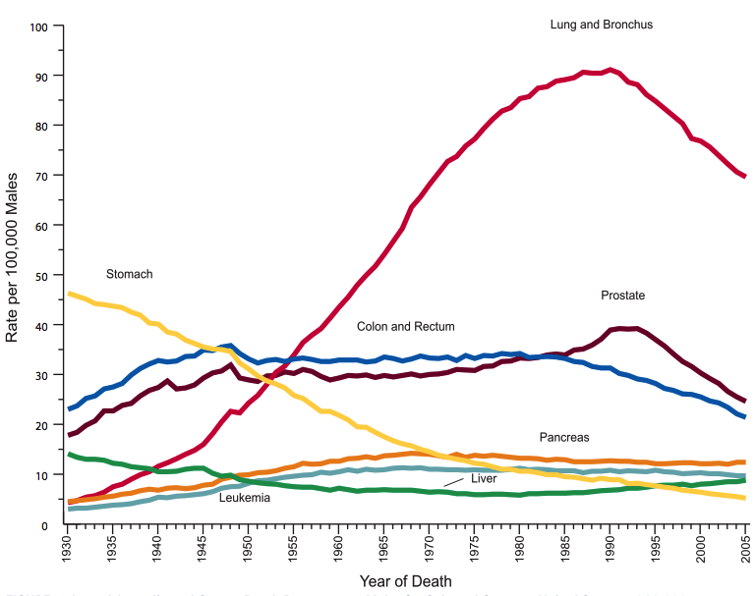
Prostate Cancer Incidence and Mortality Post-PSA
Cancer incidence, 1975-2005
Disease-specific cancer death rate in males, 1930-2005
Jemal, et al. CA Cancer Journal for Clinicians, 2009
Notes:
Data trends remain fairly constant……. In 2009 190,000 new cases were expected with only 27,000 anticipated deaths. Upon first glance it appears that after the advent of PSA testing mortality declines steadily. Initially this was optimistically attributed to increased detection allowing early intervention; however there is another way to view this data. There is a drastic spike in prostate cancer incidence that corresponds to national acceptance of PSA testing in the late 80s and early 90s, with its peak in 1992. This corresponds to a less noticeable spike in the mortality rate, explained simply by an increase in the denominator: more prostate cancer equals more prostate cancer deaths. However, if we take this spike out of consideration when we look at the effect of PSA on prostate cancer mortality, the reduction in cancer related mortality is much less impressive. Raising the question of the value of PSA screening.

Slide 4
Prostate cancer: Screening
The methods of screening
Who should get screening
Why is there now a CONTROVERSY about screening for prostate Ca)

Slide 5
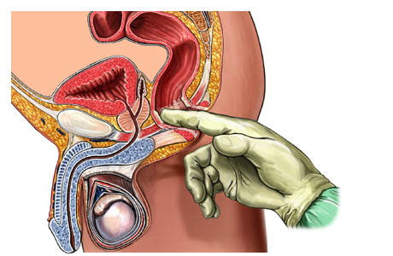
Defining Prostate Cancer Screening
Digital rectal exam
Prostate specific antigen (PSA) blood test
Performed yearly in asymptomatic men

Slide 6
Prostate Specific Antigen
Protein produced by normal tissue and cancer
Marker of benign prostatic growth and cancer
Elevates with prostatic inflammation: prostatitis, urinary retention, recent sexual activity

Slide 7
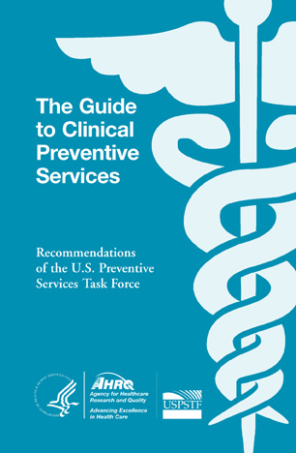
U.S. Preventative Services Task Force 2011
Analyses show no difference in prostate cancer-specific or overall mortality between screened and unscreened patients
US Preventative Services Task Force does not support PSA screening
Notes:
Reminder: a complete discussion of the US preventative service task force opinion is beyond the scope of this talk…….. However, briefly, the evidence presented here, while not painting screening in a favorable light, is not intended to condemn PSA screening. However, the most valuable message to be garnered from the Task Force recommendation is a plea for rational, considerate use of the information gained from screening, and that is what I will advocate in my remaining time……
As a clinician I look at this data and conclude that there is either an issue with the screening test, or our treatments aren’t very good. The discussion of appropriate biomarkers for prostate cancer is another talk entirely, but it is logical to question the oncologic utility of our interventions.

Slide 8
PROSTATE CANCER SCREENING
PROS
CONS
Earlier Diagnosis
May find smaller lesions that require less radical surgery
May lead to cure in an individual patient
For society at large screening not shown to improve cure rates.
May find lesions that require more testing
May trigger multiple biopsies over time
May lead to Surgery or RT in men who do not need treatment at all

Slide 9
Diagnosis by Biopsy & Prognosis
It’s all about the Numbers-The Gleason Score

Slide 10
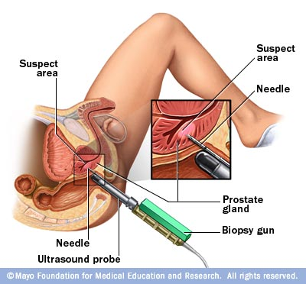
Transrectal Ultrasound Guided Biopsy
Proper positioning and set-up for prostate biopsy

Slide 11
Gleason Scoring Dictates Prognosis
The pathologist looks at the biopsies under the microscope
Dr. Gleason determined 5 different appearances scored 1-5, least to most aggressive
Types 1 and 2 are now considered benign (not cancer)
We pick the two most common types within the biopsy and add the scores together
The most common type is listed first so…..
because 4+3 indicates more type 4 cancer
3+3=6 → 5+5=10
4+3=7 is worse than 3+4=7

Slide 12
TREATMENT !
A new Thought—Not every patient needs treatment

Slide 13
Early Prostate Cancer-Types of Treatment
Surgery (prostatectomy)
Radiation Therapy
External beam
Brachytherapy (seeds)
Radiation Therapy + Hormone therapy
Surveillance

Slide 14
Side Effects of Androgen Deprivation Therapy
Sexual dysfunction-ED; loss of libido
Loss of muscle mass and strength (sarcopenia)
Bone loss-osteopenia/osteoporosis
Gynecomastia (breast swelling and pain)
Hot flashes
Fatigue syndromes
Neurologic and cognitive changes
Cardiovascular and metabolic effects

Slide 16
Advanced Prostate Cancer-Types of Treatment
Hormonal therapy
Androgen Deprivation therapies
Chemotherapy
Vaccine therapy
Bone directed therapies
Experimental targeted therapies

Slide 17
Managing side Effects
Incontinence
Sexual Dysfunction
Bone health
Role of Exercise

Slide 18
QUESTIONS & COMMENTS
THANK YOU!

